Slide 1
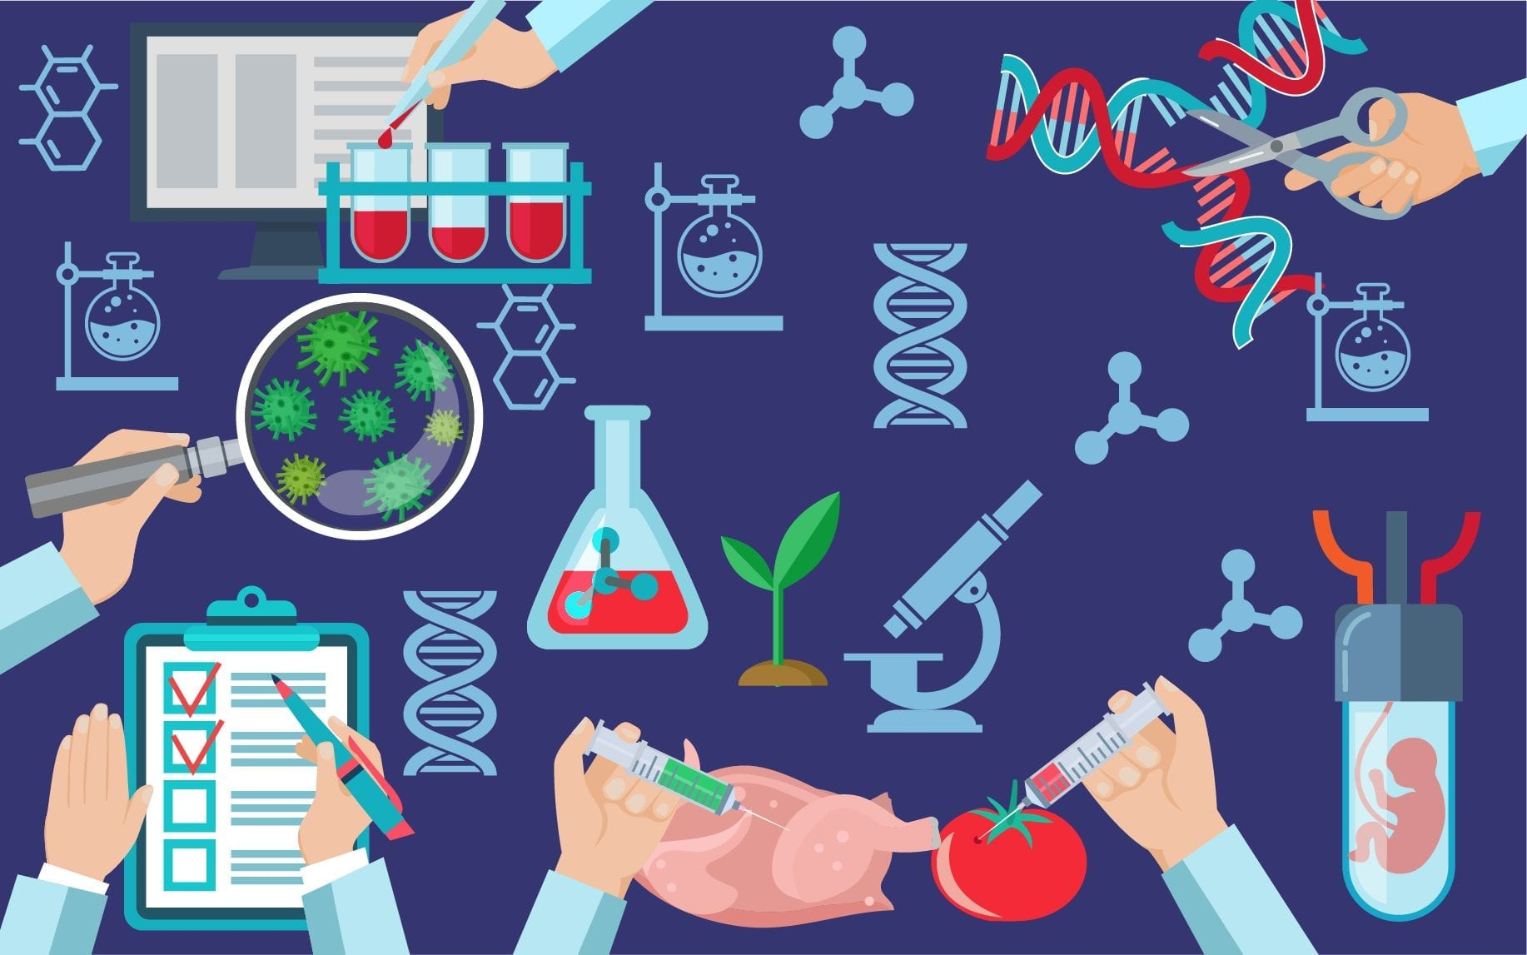
Applications of biotechnology
By K.G.N.P.Kebelhitiyawa
SC1172: Introduction to Information Technology

Slide 2
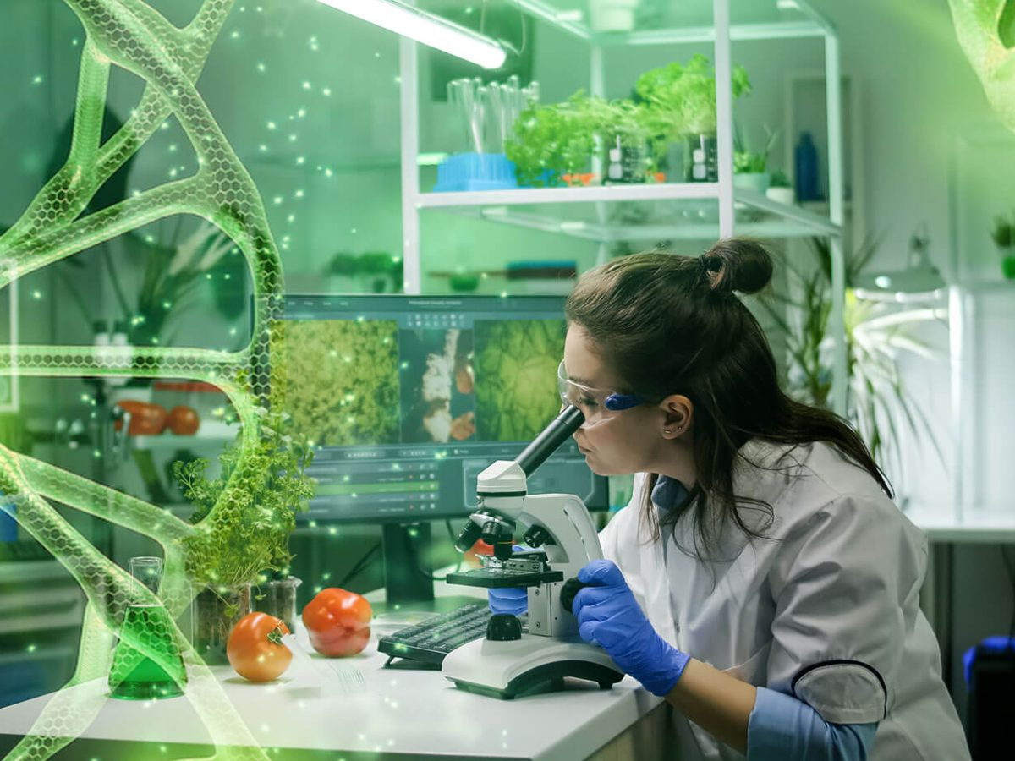
What is biotechnology?
Any technique that uses living organisms or substances from those organism, to make or modify a product, to improve plant or animal, or to develop microorganism for specific uses.

Slide 3
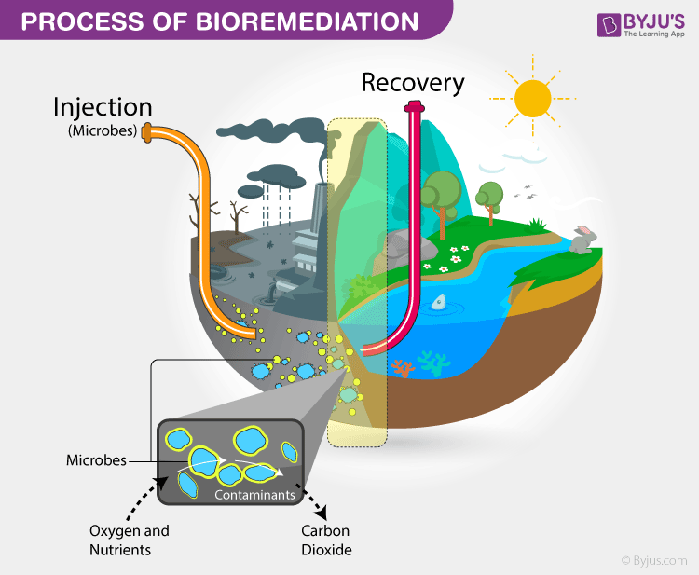
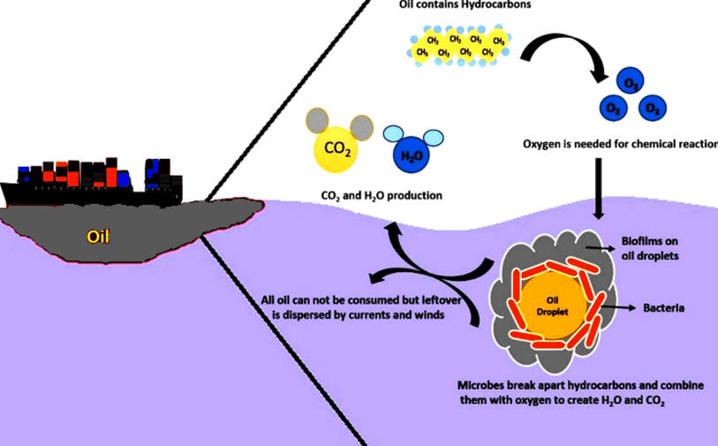
Environmental biotechnology
Bioremediation
Bioremediation is a biotechnical process, which abates or cleans up contamination.
It is a type of waste management technique which involves the use of organisms to remove or utilize the pollutants from a polluted area.
Ex: 1.Oil Spill Cleanup
2.Heavy Metal Removal
3.Wastewater Treatment

Slide 4
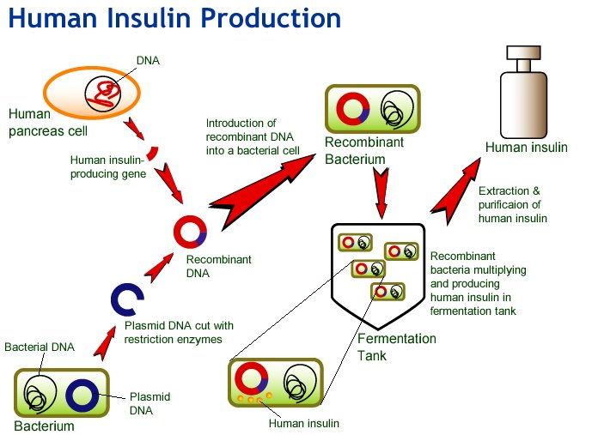
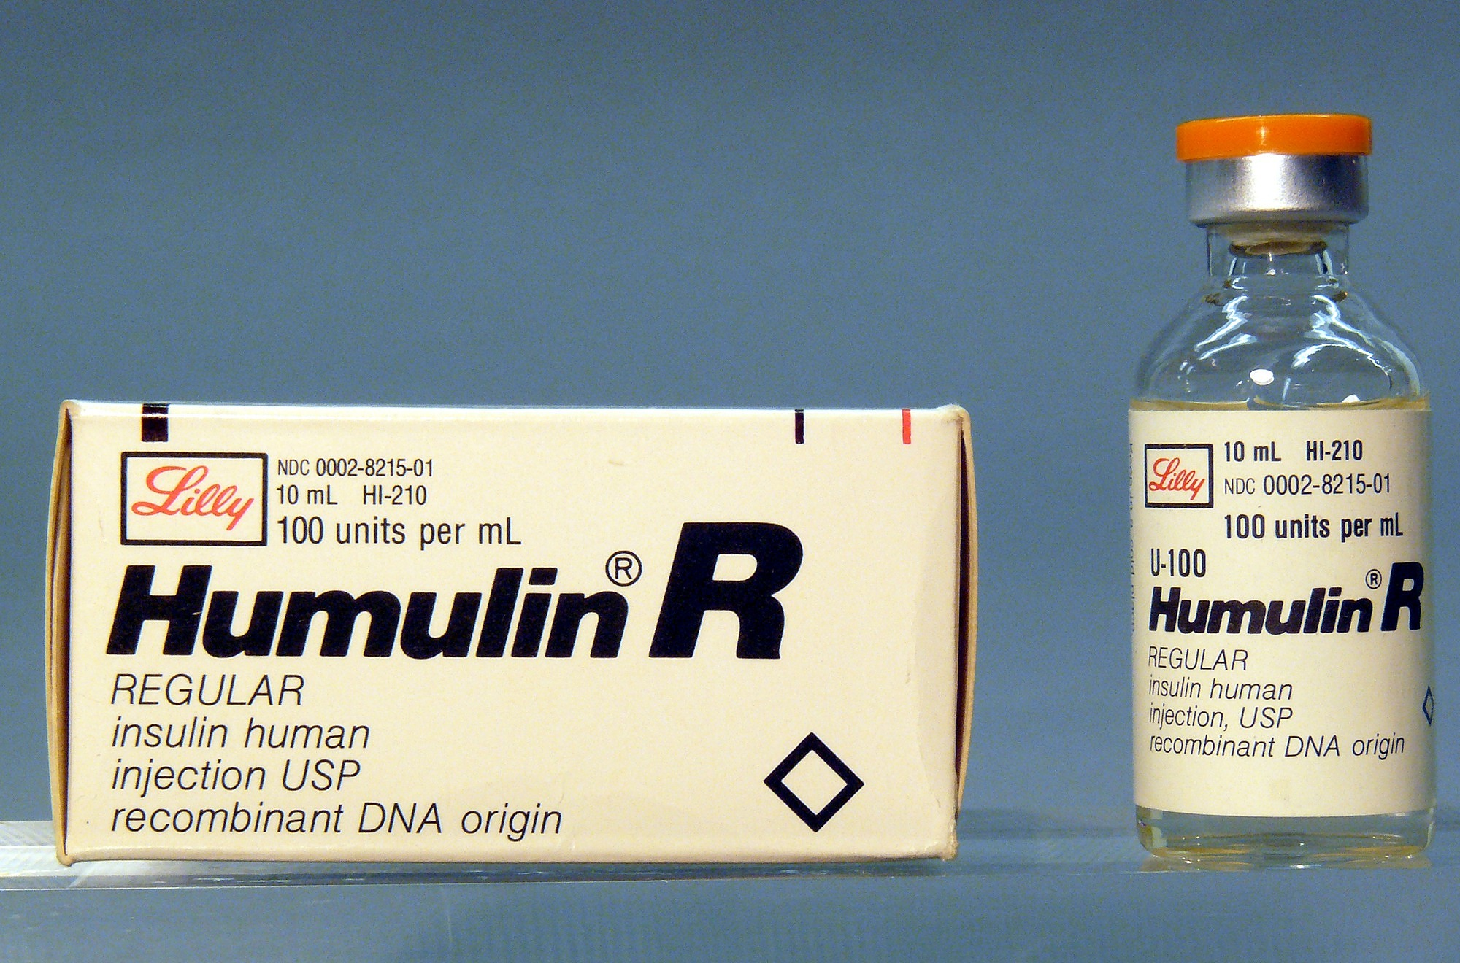
Medical biotechnology
Genetically engineered human insulin
Genetically engineered human insulin, first introduced by Eli Lilly in 1982.
It is a synthetic insulin produced using recombinant DNA technology in bacteria like Escherichia coli to treat diabetes by mimicking natural human insulin.

Slide 5
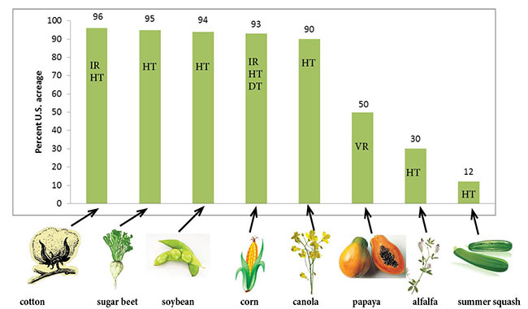
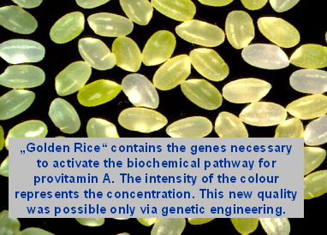
Agricultural biotechnology
Genetically Modified (GM) crops
Genetically Modified (GM) crops are plants altered using biotechnology for improved traits like pest resistance or higher yield.
Examples include Bt cotton, Roundup Ready soybeans, and Golden Rice, engineered for better nutrition or resilience.
The mid-1990s grown GM crops in the U.S., traits for which they are modified, and percent of total acreage of the crop that is planted to GM varieties. IR=insect resistant, HT=herbicide tolerant, DT=drought tolerant, VR=virus resistant.
Notes:
Golden rice is genetically modified to produce beta-carotene, which is not normally present in rice. Beta-carotene is converted into vitamin A when metabolized by the human body. We need vitamin A for healthier skin, immune systems, and vision. The endosperm of Golden Rice (Oryza sativa) is yellow due to the accumulation of β-carotene (provitamin A) and xanthophylls. The product of the two carotenoid biosynthesis transgenes used in Golden Rice, phytoene synthase (PSY) and the bacterial carotene desaturase (CRTI), is lycopene, which has a red color.

Slide 6
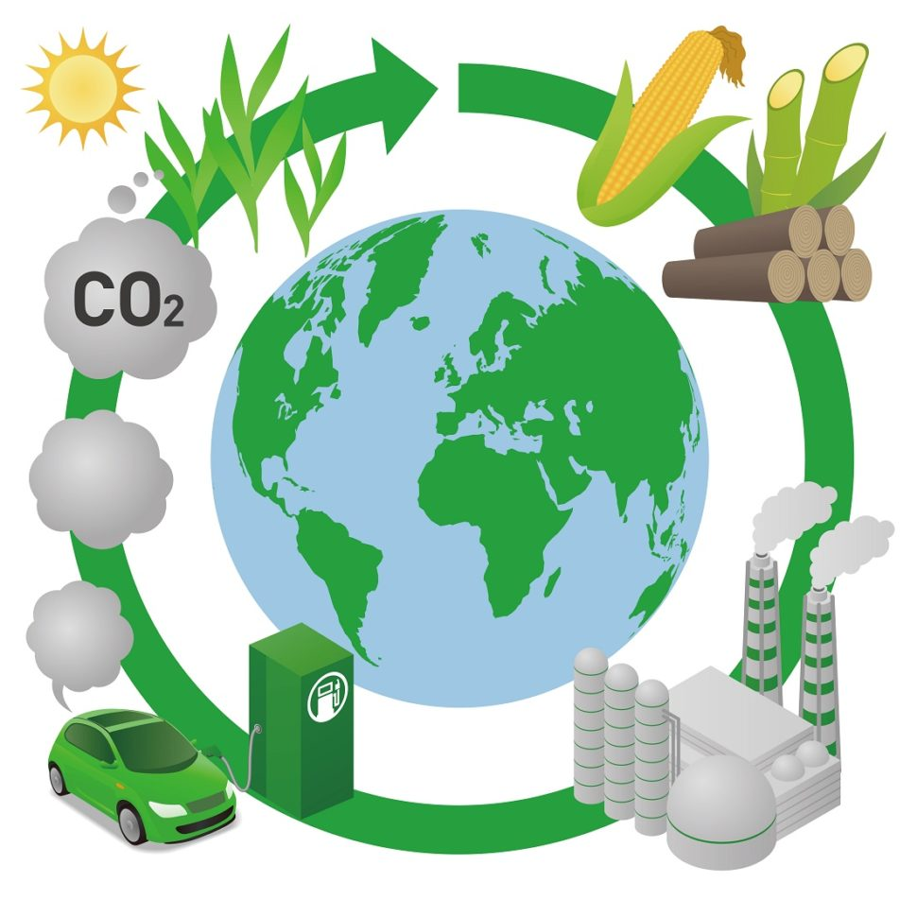
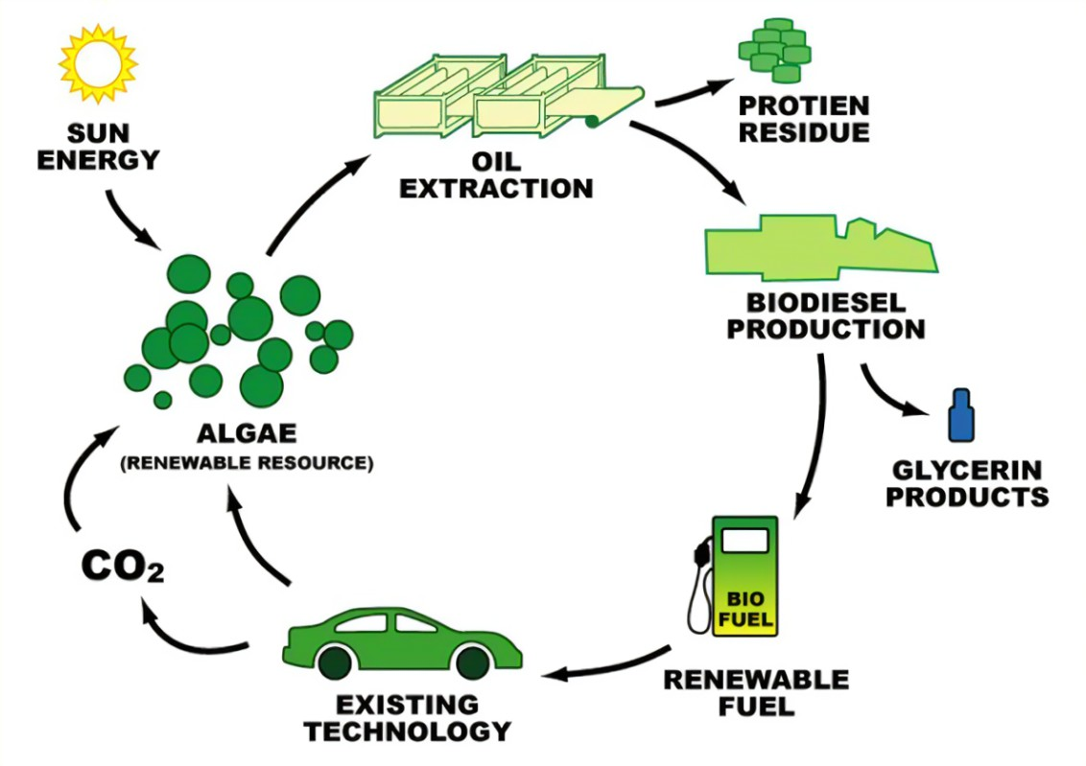
Industrial biotechnology
Bio fuels
Biofuels are renewable energy sources made from organic materials like plants, algae, or waste.
They reduce greenhouse gas emissions and can replace fossil fuels in transportation, offering a sustainable alternative to conventional energy sources.
Ex: 1. Ethanol
2.Biodiesel
3.Biogas

Slide 7
References
Applications of biotechnology in food & agriculture https://www.ncbi.nlm.nih.gov/pmc/articles/PMC8751662/
Bio fuel https://www.energy.gov/eere/bioenergy/biofuel-basics
Bioremediation https://www.ncbi.nlm.nih.gov/pmc/articles/PMC9413587/
GM crops, Colorado states university https://extension.colostate.edu/topic-areas/agriculture/genetically-modified-gm-crops-techniques-and-applications-0-710/

